Slide 1
SAVE ME TIME
Research Week 2014

Slide 2
A caveat
We are not the university authority

Slide 3
What are we talking about?
Buzzwords, buzzwords, buzzwords
Storage
Applications

Slide 4
Benefits
Universal access
Backup
Sharing

Slide 5
University services
Microsoft OneDrive (formerly SkyDrive)
http://onedrive.live.com/
Office 365 (Outlook)
https://outlook.com/curtin.edu.au
Blackboard
http://lms.curtin.edu.au/
Endnote Online
https://www.myendnoteweb.com/EndNoteWeb.html

Slide 6
Other popular services
Dropbox
https://www.dropbox.com/
Google Drive
https://drive.google.com/
Evernote
https://www.evernote.com/
Password managers

Slide 8
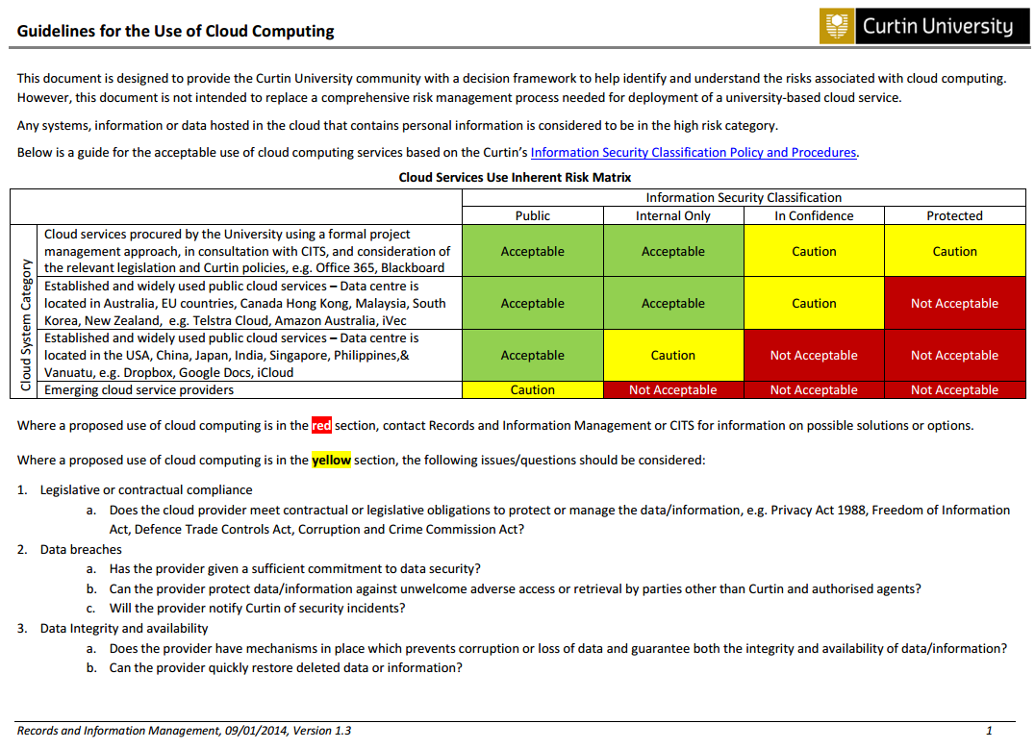
http://rim.curtin.edu.au/local/docs/CloudComputingGuidelines.pdf

Slide 9
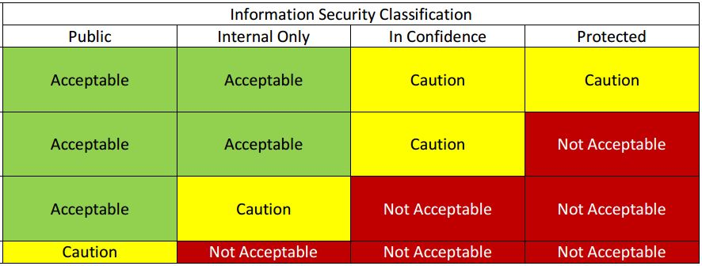
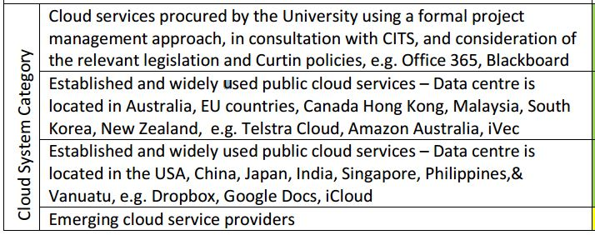
1.
2.
3.
4.
1.
2.
3.
4.

Slide 10
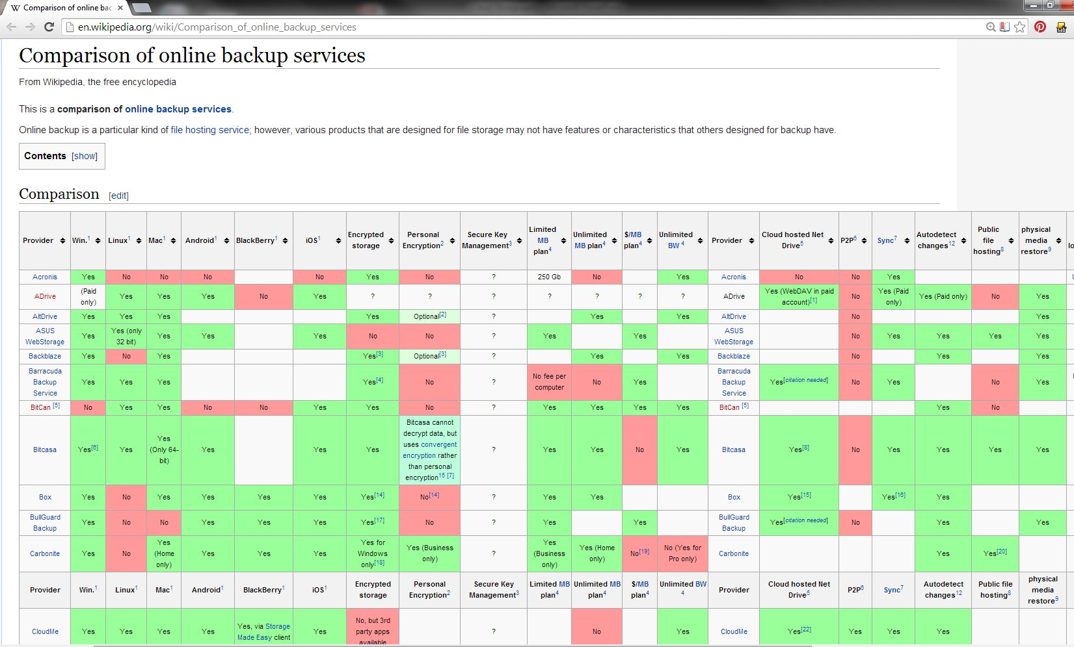
http://en.wikipedia.org/wiki/Comparison_of_online_backup_services

Slide 11
 | OneDrive | Dropbox | Google Drive | Box
File size restrictions? | 2GB | None with Dropbox apps | 10GB | 250MB for free plan, 5GB for paid plan
Free storage? | 7GB | 2GB | 15GB | 10GB
Can I earn extra free storage? | Yes | Yes | No | No
Paid plans | $25/year for 50GB, up to 200GB | $10/month for each 100GB, up to 500GB | $2/month 100GB, $10/month for 1TB | $10/month for 100GB
OSes supported | Windows, Mac, Android, and iOS | Windows, Mac, Linux, Android, iOS, Blackberry, Kindle Fire | Windows, Mac, Android, and iOS | Windows, Mac, Android, Blackberry, and iOS
http://www.cnet.com/au/news/onedrive-dropbox-google-drive-and-box-which-cloud-storage-service-is-right-for-you/

Slide 12
Picture credits
Cumulus cloud before rain by Joydeep
http://commons.wikimedia.org/wiki/File:Cumulus_cloud_before_rain.jpg

Slide 13
Save me time: How to get the most out of the cloud EndNote Online
17 July 2014
Curtin University is a trademark of Curtin University of Technology
CRICOS Provider code 00301J

Slide 14
What is EndNote?
EndNote is a software application that
stores, manages and searches for your references
builds lists of references cited in a paper and at the click of a button will create the bibliography in a number of different styles
references from other databases into an EndNote library

Slide 15
What is EndNote Online?
EndNote Online is the counterpart to the EndNote desktop version
It can store up to 50,000 references and 2GB of attachments

Slide 16
Why EndNote Online?
Search and view EndNote Online references from any mobile device
Import references from a large number of library indexes and databases
Organize your references into groups
Create an independent bibliography in a variety of styles
Synchronize your references between your desktop library, your online library and your iPad
Use webpage reference capture
Collaboration is easy with share (read and write) access to your references and groups with your colleagues

Slide 17
EndNote Online

Slide 18
Want to know more?
Getting started with EndNote
EndNote Extras and EndNote Online
Researcher ID and EndNote Online
See your Faculty Librarian
EndNote LibGuides
Notes:
With EndNote for iPad, make PDF annotations directly within the app. Then access and edit them from your EndNote desktop or online account.

